Slide 1
Baseline PEBB RTDS Model

Slide 2
RTDS/Kria CHIL

Slide 3
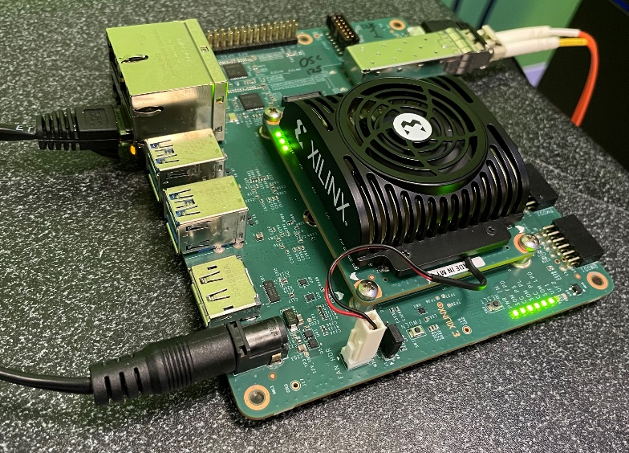
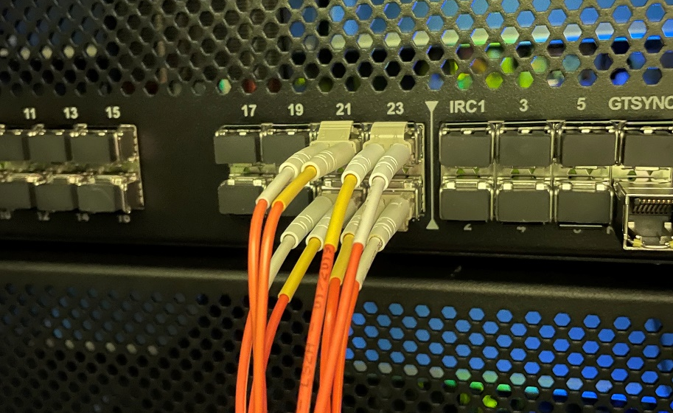
Kria CHIL
Aurora Link
PEBB C-code instantiated on
Kria in A53 CPU for real-time operation
FPGA drives Aurora interface
Model of PEBB, grid, & load(s)
running in RTDS

Slide 4
System Model

Slide 5
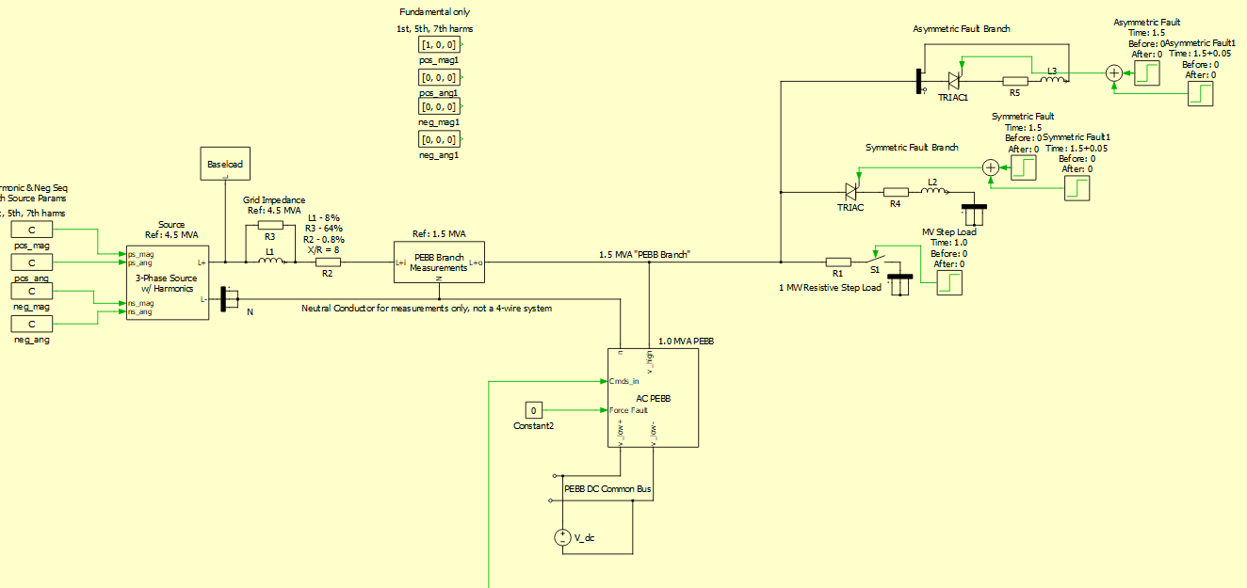
PLECS Model
H.V. load
H.V. load
Commanded power flow
Stiff DC bus

Slide 6
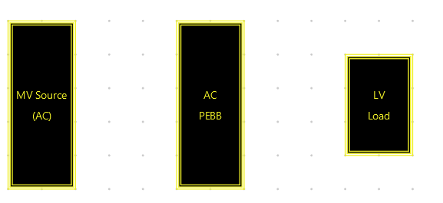



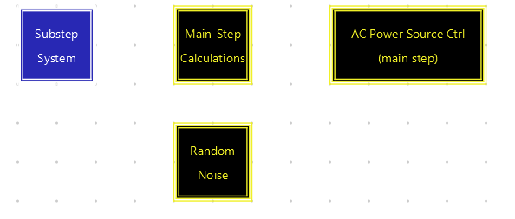


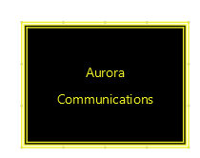
RTDS Model Overview
Large step – 125 us
Substep – 125us/N
N = 24-60

Slide 7
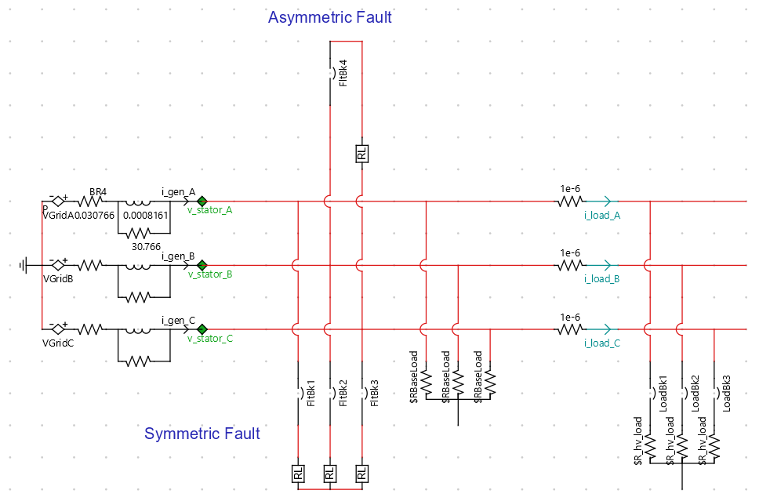
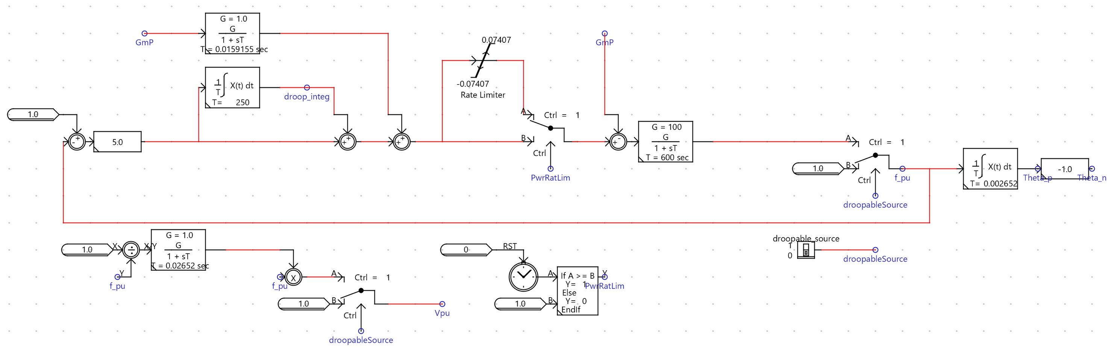
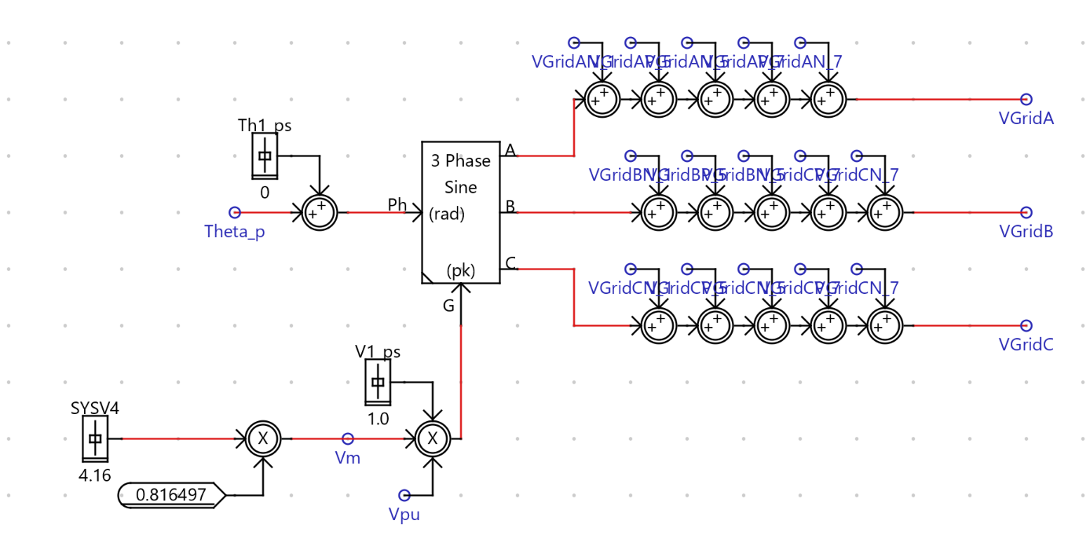
RTDS Model-Droopable MV Grid
Grid
Turbine model
Droop control
Base load
Switchable load
Optional harmonic injection

Slide 8
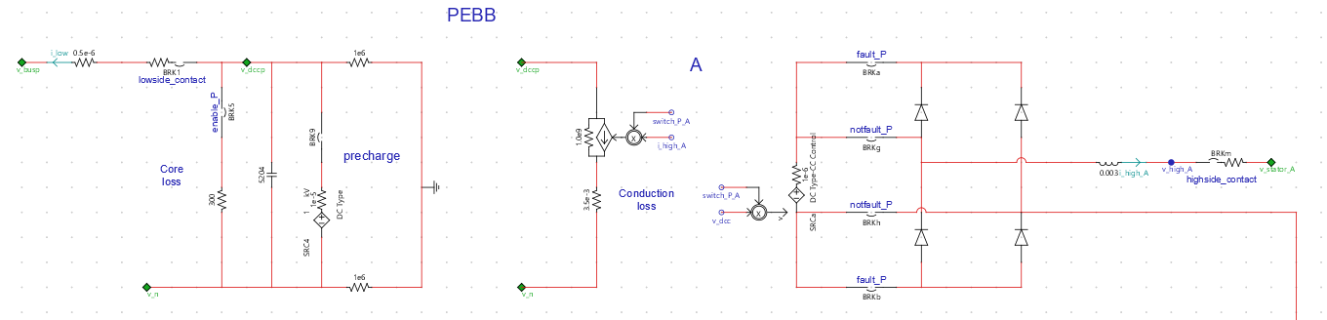
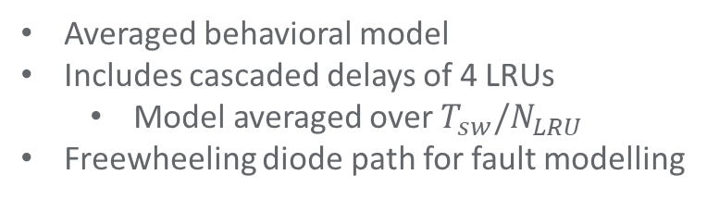
RTDS Model-PEBB
A-phase
To DC
bus
B
N
Averaged behavioral model
Includes cascaded delays of 4 LRUs
  Model averaged over $T_{sw}/N_{LRU}$
Freewheeling diode path for fault modelling
N
C
N
B & C phases
(Y-conn. output)

Slide 9
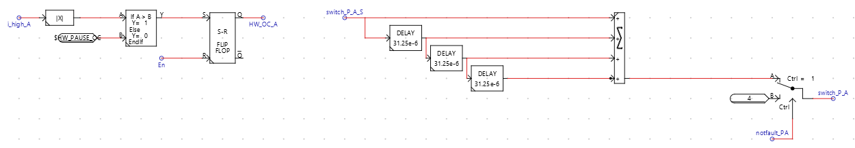
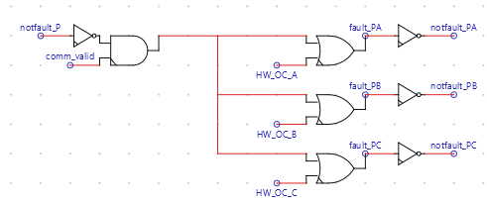
PEBB Phase Shift & Fault Logic
PEBB Phase shift
4x LRUs each interleaved with delay from previous unit
Gate-Pause Logic
Gating stops for rest of PWM cycle on overcurrent
Fault logic
Fault signal from controller or local gate pause triggers

Slide 10
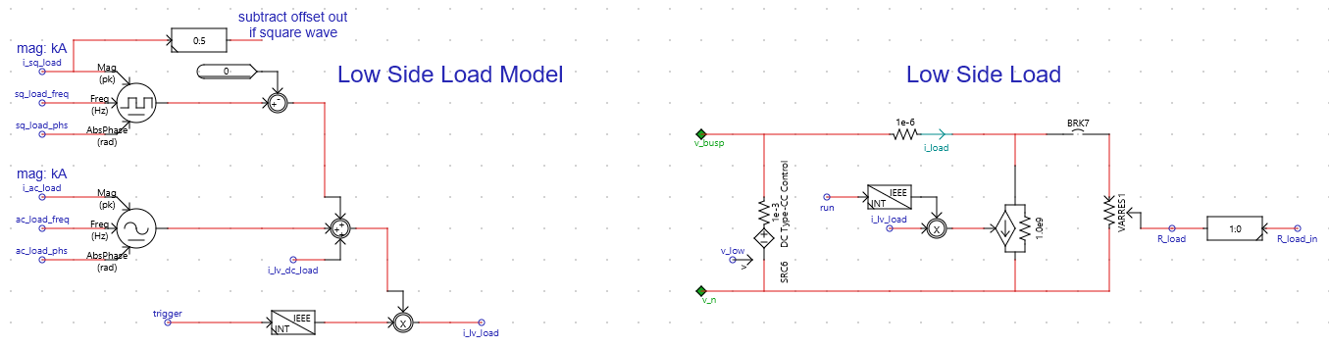
Low-Side Model
Both PLECS model & RTDS models assume stiff low-side bus voltage for now
Adjustable low-side loads can be added in
Stiff Low-Side Bus

Slide 11
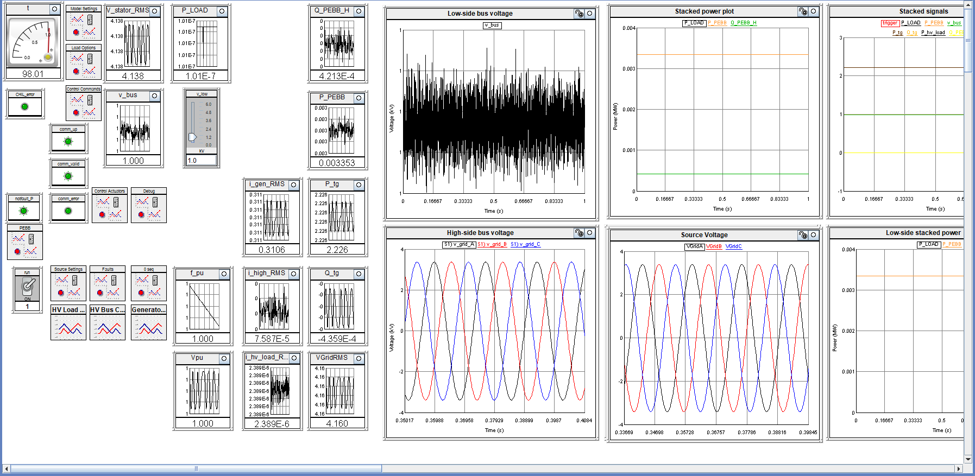
RTDS User Panel

Slide 12
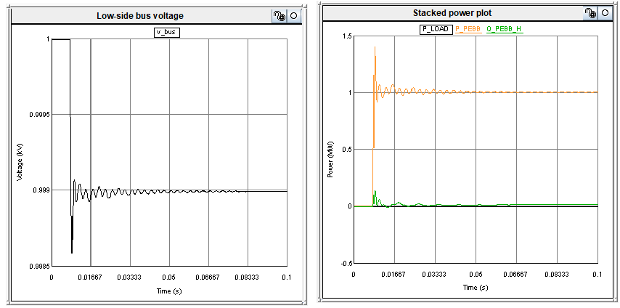
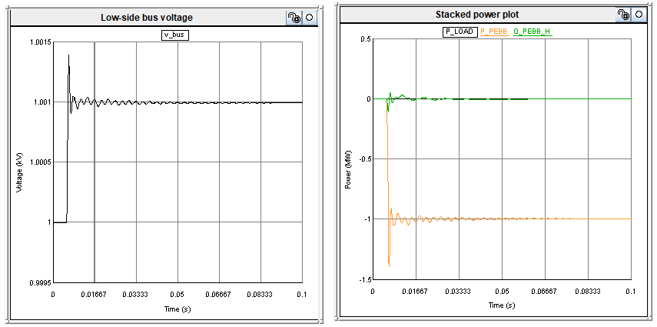
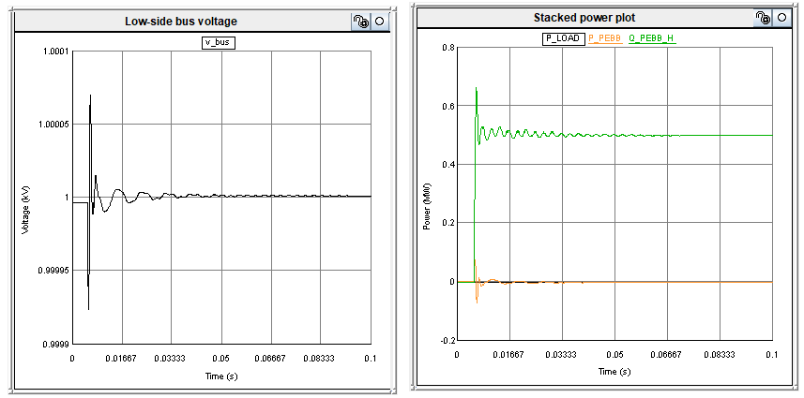
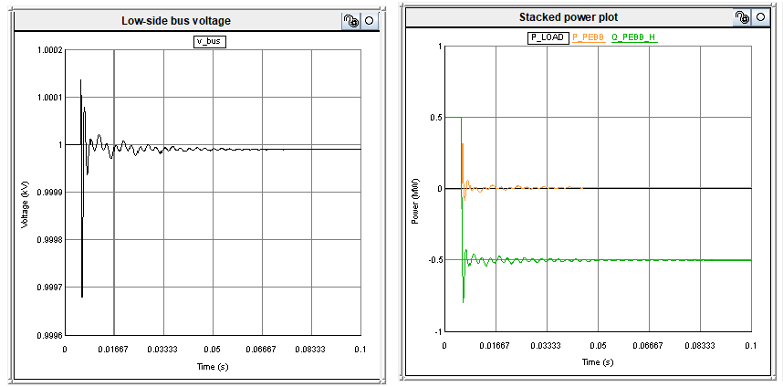
Simulation Examples
Case 1: PEBB command step 0 MW to 1 MW (sourcing to gid)
Case 2: PEBB command step 0 MW to -1 MW (sinking from grid)
Case 3: PEBB command step 0 MVAR to 0.5 MVAR upstream
Case 4: PEBB command step 0 MVAR to -0.5 MVAR upstream

Slide 13
Simulation Examples
Case 5: 1 MW Load Step on HV Side
Case 6: 1 MW Load Step on HV Side

Slide 15
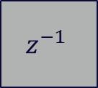
Aurora Loopback Timing in Substep
(Timing assumes N=50 substeps per main step)
Substep Environment Variables
Sample & hold (in sub step)
Aurora Block
(in sub step)
Sample every N packets
Kria
0 substeps
0 substeps
0 us
0 us
0 substeps
0 substeps
~3+ sub steps loopback
0 us
0 us
~7.5+ us
Clk @ 2.5 us
(400 kHz)
Clk @ 2.5 us
(400 kHz)
Clk @ 125 us
(8 kHz)
Ctrl @ 125 us
(8 kHz)
This approach avoids substep -> mainstep communication delays, but increases communications/FPGA complexity
  Have an Aurora decimator to downsample Aurora packets in FPGA
RTDS
S&H
Controller
$$z^{−1}$$
1 main step/125 us
March 13, 2024
15

Slide 16
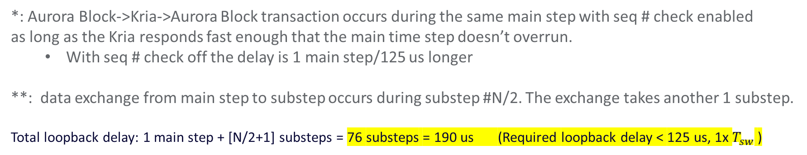
Aurora Loopback Timing with Aurora Running in Main Step @ 8 kHz
(Timing assumes N=50 substeps per main step)
Substep Environment Variables
1 main step
Main step Environment Variables
0 main steps
Aurora Block
(in main step)
0* main steps
Kria
125 us
0 us
0* us
N/2+1 substeps**
0 main steps
0* main steps
65 us
0 us
0* us
Clk @ 2.5 us
(400 kHz)
Clk @ 125 us
(8 kHz)
Ctrl @ 125 us
(8 kHz)
Clk @ 125 us
(8 kHz)
*: Aurora Block->Kria->Aurora Block transaction occurs during the same main step with seq # check enabled
as long as the Kria responds fast enough that the main time step doesn’t overrun.
  With seq # check off the delay is 1 main step/125 us longer
**: data exchange from main step to substep occurs during substep #N/2. The exchange takes another 1 substep.
Total loopback delay: 1 main step + [N/2+1] substeps = 76 substeps = 190 us (Required loopback delay < 125 us, 1x $T_{sw}$ )

